Slide 1

Anatomy of an Ethereum client
Andrei Maiboroda github.com/gumb0
Devcon3
Notes:
- In this talk I'd like to quickly overview the internals of an Ethereum client implementation.
- I am familiar most of all with C++ client implementation, but there're a lot of common ideas behind all of the clients and in this talk I'm not going to tell about C++ client in particular, but about the general view of what any client should consist of, the things that you definitely need to implement as a part of any client
- This talk might be interesting to anyone who is new to this topic and is wondering about the practical details about how Ethereum works under the hood, or to anyone who might be considering implementing a new Ethereum client using their favorite programming language. And I could recommend it as a best way to get a deeper understanding of the protocol.
- I'm sure everyone knows what a client is, it's a piece of software that allows you to connect to Ethereum network, run a node and interact with Ethereum.
- And usually all the teams working on the clients clearly separate any user-friendly GUI from the client backend and it this talk by the client I mean only the backend core part, not intended to be end-user-friendly.
- Essentially a client is an implementation of the Ethereum protocol as specified by the Yellow Paper, the main formal specification of Ethereum. But not only that.

Slide 2
Ethereum client
RPC API
Wallet
Optional stuff
Blockchain
State
EVM
PoW
Consensus
tests
Sync
Network
Database
Notes:
This is a high-level overview of more or less everything you can find in the client.
The middle part (in yellow) is the implementation of the Ethereum protocol itself, it is the part specified by the Yellow paper and this is where all client developers should follow the specification very carefully, because it directly affects consensus in the network, and if there's some disagreement in how a client should behave it can lead to the unintentional fork in the network.
All the rest is where developers have some freedom in choosing the approach/technology/strategy of how to implement it or for some parts maybe whether to implement it at all.

Slide 3
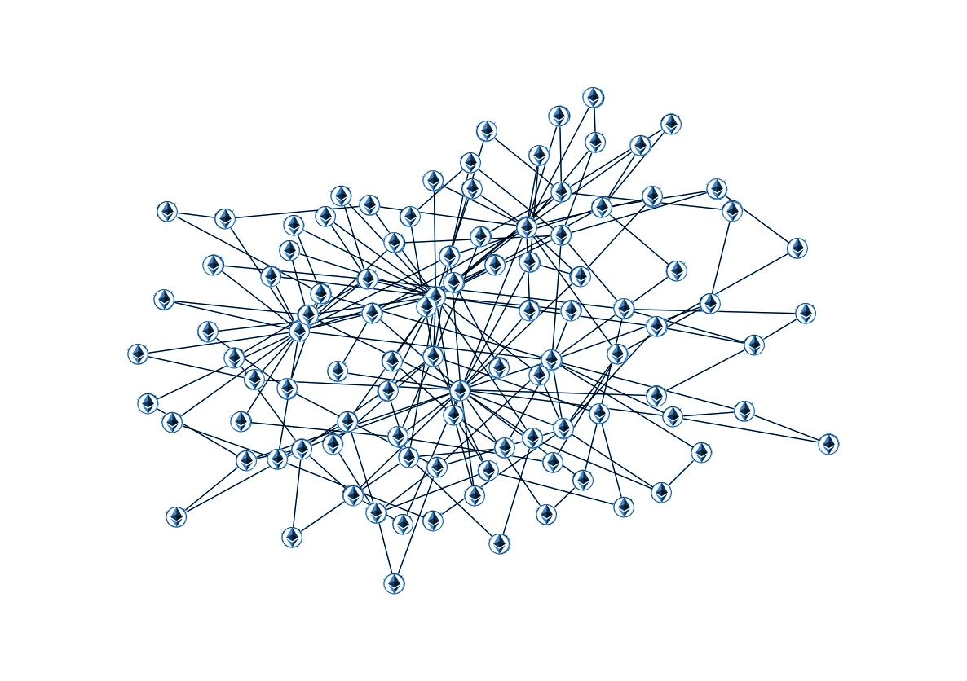
Network communication
Discovery protocol
devp2p & RLPx
eth protocol
Fast sync protocol
Warp protocol
etc.
Notes:
The networking layer is essentially the implementation of the peer-to-peer protocol which specifies how the nodes in the ethereum network communicate with one another.
In fact this is not one single protocol, but a family of protocols.
One important of them is the node discovery protocol (that is the algorithm of how the nodes find one another in the network).
Others are nicely designed as two levels of protocols: the lower-level protocol is called devp2p, and together with something even lowel-level (transport level) called RLPx basically specify how the nodes in the network can exchange binary-encoded messages. BTW for binary serialization of the data, ethereum uses a special format called RLP (which stands for recursive length prefix) and it's used not only in networking but everywhere in the ethereum protocol. So devp2p basically specifies how the nodes can talk to one another with RLP-encoded messages.
Other higher-level protocols are based on devp2p and they specify which data exactly can be exchanged.
So eth protocol specifies how the nodes exchange the mined blocks and the unmined pending transactions.
There are also other protocols which are used to download the data during fast and warp sync and they are also based on devp2p.

Slide 4
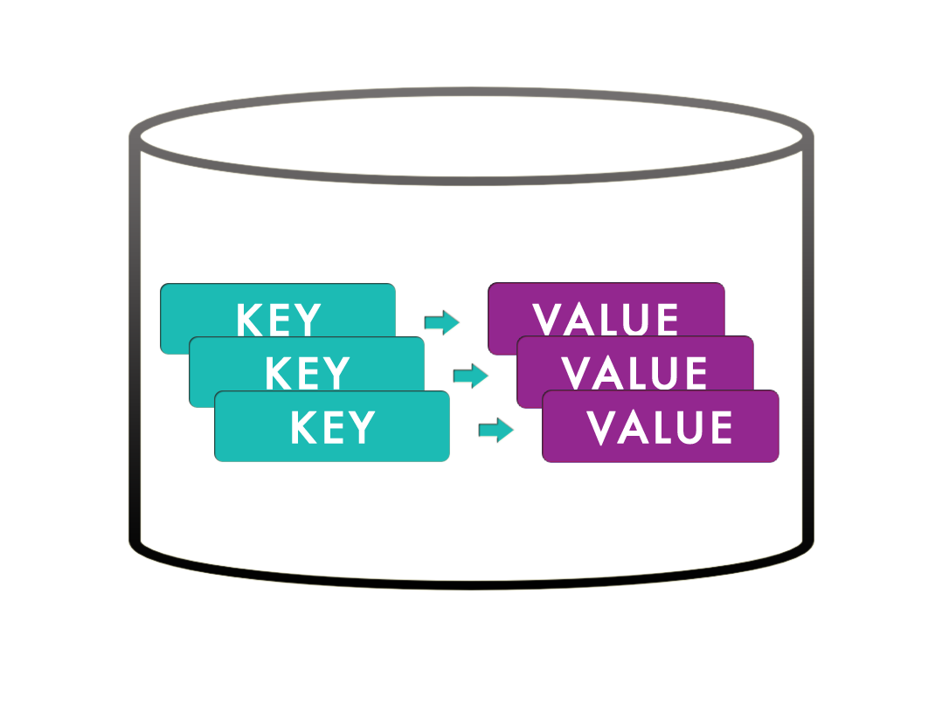
Databases
Blockchain database
State database
Indices
Caching
Pruning
Notes:
Any client needs some persistent storage for the blockchain and the state data. Typically clients use some kind of key-value storage database, because this fits naturally all the needs of an ethereum client. cpp-ethereum and go-ethereum for example both use LevelDB for that.
What is this distinction between the blockchain and the state data. It can in fact be stored all in the single database or in separate databases but anyway it's pretty distinct data. The blockchain is obviously the storage for all of the blocks and all of the transactions of blocks.
And the state data is kind of orthogonal to that. It is the information about all the accounts currently existing in Ethereum, their balances, nonces, code of contracts, storage of contracts.
Also typically the clients implement some indexing and caching strategies on top of the database to make queries more efficient.
Some clients have also some pruning strategy for the state data, that is compacting the state database by removing some older parts of it that are not normally needed.

Slide 5
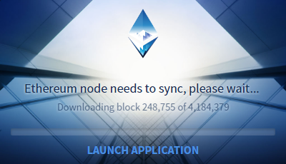
Synchronization
Full (Archive) sync Downloads all blocks and executes all txs
Fast sync Downloads all blocks and the state trie
Snapshot (Warp) sync Downloads compressed blocks and the state
Light client Doesn’t have the full blockchain and state
Notes:
Synchronization is the process that allows us to get the blockchain and the latest state data from other nodes of the network. So we can say that it is built on top of both networking and the database layers, as it gets the data over the network through one of the network protocols and this data ends up in the database.
There are currently at least three known methods to organize the synchronization
Full sync (also known as archive sync) is historically the first one that appeared in Ethereum. It downloads all of the blocks one by one and executes each and every one of the transactions. So this way you calculate the full state of Ethereum according to each processed block, and in the end you have what is called an archive node, which means that you have all of the intermediate states and you can query any of them. In practice doing this for the whole blockchain is terribly inefficient and it will take ages to complete nowadays. So almost no one really uses this by itself.
Fast sync also downloads the blocks, but instead of executing all the transactions it gets the full state of Ethereum by downloading it as well. So where the full sync calculates the state locally, the fast sync instead downloads the result of this calculation from other nodes, that's the main difference. Fast sync also for efficiency reasons skips some PoW verification for some blocks, still trying to remain as secure as possible. And in general this approach allows to make sync time pretty manageable.
Warp/snapshot sync is downloading the compressed snapshot of everything needed to start the node, including the blocks (at least some number of recent ones) and the state corresponding to the last block.
I should note that although as I said the full sync is terribly inefficient nowadays, it is nevertheless the absolutely essential component of any client.
One reason is security. Even if you don’t want to have an archive node, both fast sync and snapshot sync at some point close to being complete switch to the full sync. That way you can be sure that the latest state you have is based upon your own local transaction execution and not something you've got from the untrusted nodes on the network.
Another reason is that when your node gets behind the current chain (like for example if it was turned off for some time) you need to get all the blocks that were mined during this down time and usually the more efficient way to get these missing blocks is to get them through the full sync.
To summarize: to have a client that can be practically used as a full node in real ethereum networks, you'll need to implement at least full sync and at least one of the fast sync or the snapshot sync.
There’s also a Light Client technology, which is not exactly the form of organizing the synchronization, but a way to run a client without the need to have the full blockchain and the state. Instead of having all of the state in the local database the light client can request the needed parts of it from the peers and downloads them when needed.

Slide 6
Blockchain
Blocks
Transactions
Difficulty calculation
Signing transactions
RLP-encoding
Validation
etc.
Block
parentHash
number
difficulty
...
mixHash
nonce
uncleHash
transactions Root
receiptsRoot
state
Root
uncle
uncle
uncle
Notes:
This is the first one of the consensus-critical components, which are specified directly by the Yellow Paper. It is essentially the implementation of the rules around the data structures like the block, the transaction, for example the rules about constructing a block, filling its fields, calculating the block difficulty, the rules about signing the transaction with the user’s private key, the rules for encoding all of this in RLP format, the rules for validating blocks and transactions coming over the network, etc.
It might seem that there are many difficult rules here but I would say this part is not so complicated and pretty straightforward to implement, because it is so precisely specified and all you need is just to take care to follow the specification

Slide 7
State
Accounts
Contracts code & storage
Merkle Patricia Trie
Higher level interface to key-value storage of State DB
stateRoot
Account
nonce
balance
codeHash
storageRoot
code
Notes:
Another important part of the client data, specified by the protocol, is the State. As I already mentioned this is the current information about all the accounts and contracts of Ethereum.
So this part of the client implementation as well consists of precisely following the specification about what constitutes the account. And also what is needed from the client here is to implement this awesome tree data structure called the Merkle Patricia Trie, which allows to compactly store and efficiently query all of the state data.
This means that on the physical storage level the State database stores only the nodes of this trie. Then the responsibility of this component is to provide the higher-level interface to this storage in the form of convenient access to the ethereum accounts data.

Slide 8

Ethereum Virtual Machine
Instruction execution
Gas calculation
Updating the State
Optimizations
Interpreter vs JIT
Notes:
Ethereum Virtual Machine is the client component that executes the code of smart contracts.
More exactly what it does is first it receives some input data and the bytecode to execute. This bytecode is the binary sequence of instruction codes and their operands. (Note that EVM doesn't know anything about Solidity or any other high-level programming language.)
It executes these instructions of the bytecode, calculates the gas consumption for this execution, performs the corresponding updates of the State (for example saving something into the contract storage) and returns some result data or an error.
This is I would say rather complicated to implement part of the client. Implementing the Yellow Paper specification by itself might not be that difficult by but making it work efficiently is an important challenge and the clients have various kinds of optimizations here.
Also I should mention that there exist two different approaches to implementing the EVM: the simpler one is interpreter, that is executing the instructions one by one as we see them in the bytecode, another one is just-in-time compilation, that is translating the bytecode into the real hardware machine code and then executing it.

Slide 9
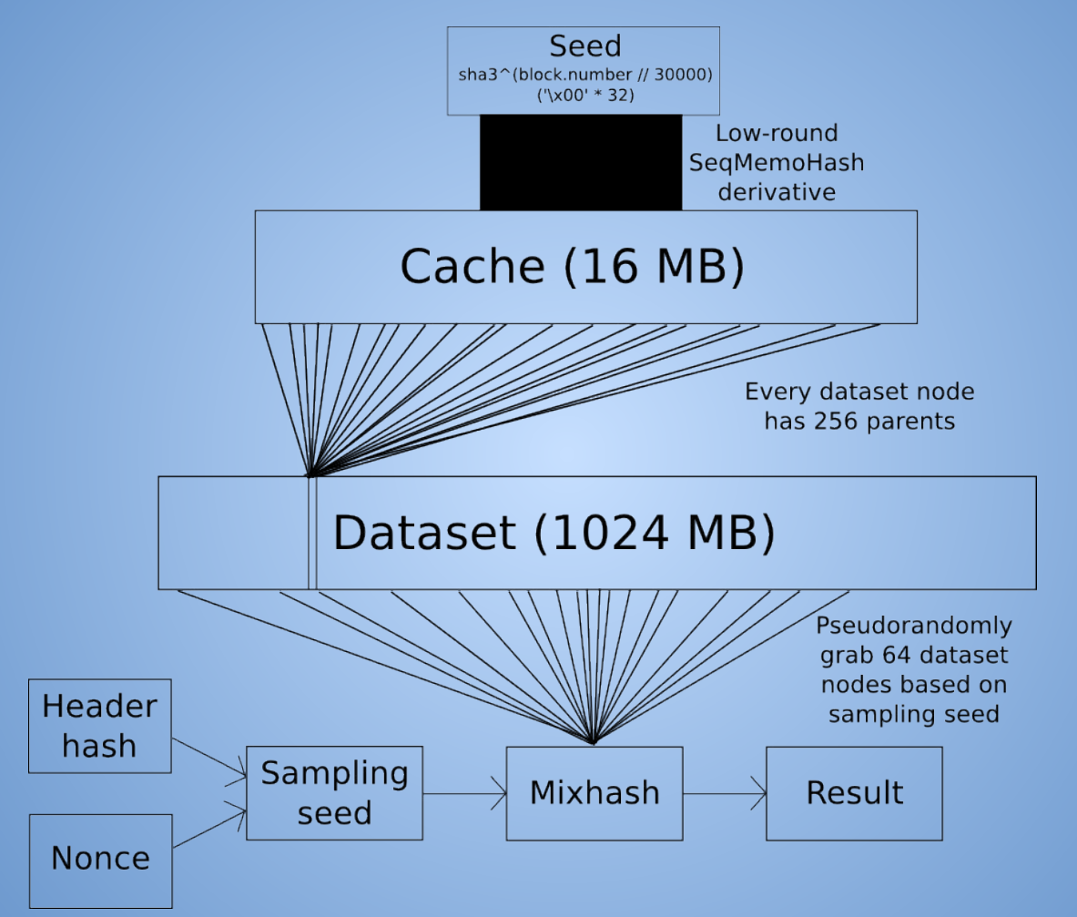
Proof of Work
Ethash
Block seal validation
Sealing new blocks
Other seal engines (Rinkeby, Kovan)
Notes:
This is the implementation of Proof-of-Work algorithm currently still used by Ethereum, called Ethash.
The client needs it mainly for two purposes - one is to validate the mined blocks that we receive over the network from other peers and another one is if the client also supports mining - to create new blocks.
Some clients also support some other kinds of sealing algorithms, like Proof-of-Authority sealing for Rinkeby or Kovan networks

Slide 10
RPC API
Backend for web3.js
JSON-RPC
Can be used remotely
https://github.com/ethereum/wiki/wiki/JSON-RPC
Dapp
Client
Ethereum
web3.js
JSON-RPC
Notes:
RPC is the primary way for the Dapps to communicate with the client, and since the Dapps might be considered the primary users of the Ethereum clients, RPC is in this sense the main interface of the client.
If you're a Dapp developer, then you know that RPC is what underlies web3.js interface which is used in the Dapp code to communicate with the node.
JSON-RPC is used as a RPC protocol
Note also that it can be used both with the locally run client and remotely through HTTP
And there’s the the link to the API specs, all the clients to be usable should provide at least the methods specified in this document.

Slide 11

Wallet
Needed to send the transactions
Managing accounts
Import/export
Signing the transactions
Notes:
Every client should have at least the very basic wallet functionality if it expects the Dapps using it to create and send the transactions. And of course usually you would want that, so all the clients typically have support for this.
This doesn't necessary mean that we need any kind of a end-user friendly graphic interface, it’s just a backend we’re talking about, so all we need here is to have a wallet functionality and an access to it through RPC.
So the client should at least have the ability to manage user's accounts (like create, import/export, list the accounts etc.) and the ability to sign the transactions with the account's private key.

Slide 12
Optional stuff
Import/export blockchain
Console
Debugging tools
Compilers
Mining
Optimizations
etc.
Notes:
And here are some features that are not so critical but are nice to have in the client as they can make the user's life easier, both for human users and the Dapps.
So this could be
Import & export of blockchain data.
Interactive console supporting web3.js calls
Additional tools useful for debugging. For example a tool for running EVM code and seeing its results.
Compilers from high-level languages like solidity, lll or serpent
Also I mention the mining here. It's kind of a big and important feature of course, but in fact it's not really an indispensable part of the client, you don't need to have mining support in you client for it to be usable by the Dapps. It can be completely separated from the client itself, like we did it for cpp-ethereum - having a GPU miner as a completely separate project

Slide 13
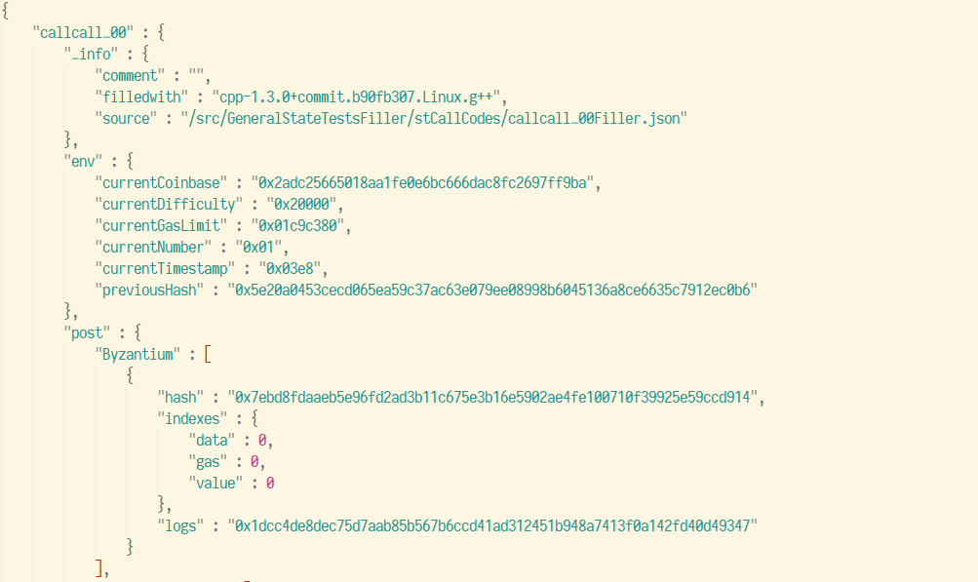
Consensus Tests
Parse JSON tests
Execute operations
Compare with expected state
Pass all the tests
Notes:
Consensus tests are a comprehensive corpus of tests developed and maintained by our testing team. Essentially they are JSON files, each one specifying some initial state of Ethereum, some operations on it (in the form or transactions, blocks) and expected state after that. What is required from the client implementation here is to be able tparse these files, run the test and compare the final state. And to pass all of the tests, of course.

Slide 14

Ethereum client
RPC API
Wallet
Optional stuff
Blockchain
State
EVM
PoW
Consensus
tests
Sync
Network
Database
Notes:
And this concludes my overview of the the building blocks of the Ethereum client. If you're interested in getting into more details you're welcome to dive into code repositories & documentation or to join developer gitter channels.
Thank you for your time.

